Slide 1
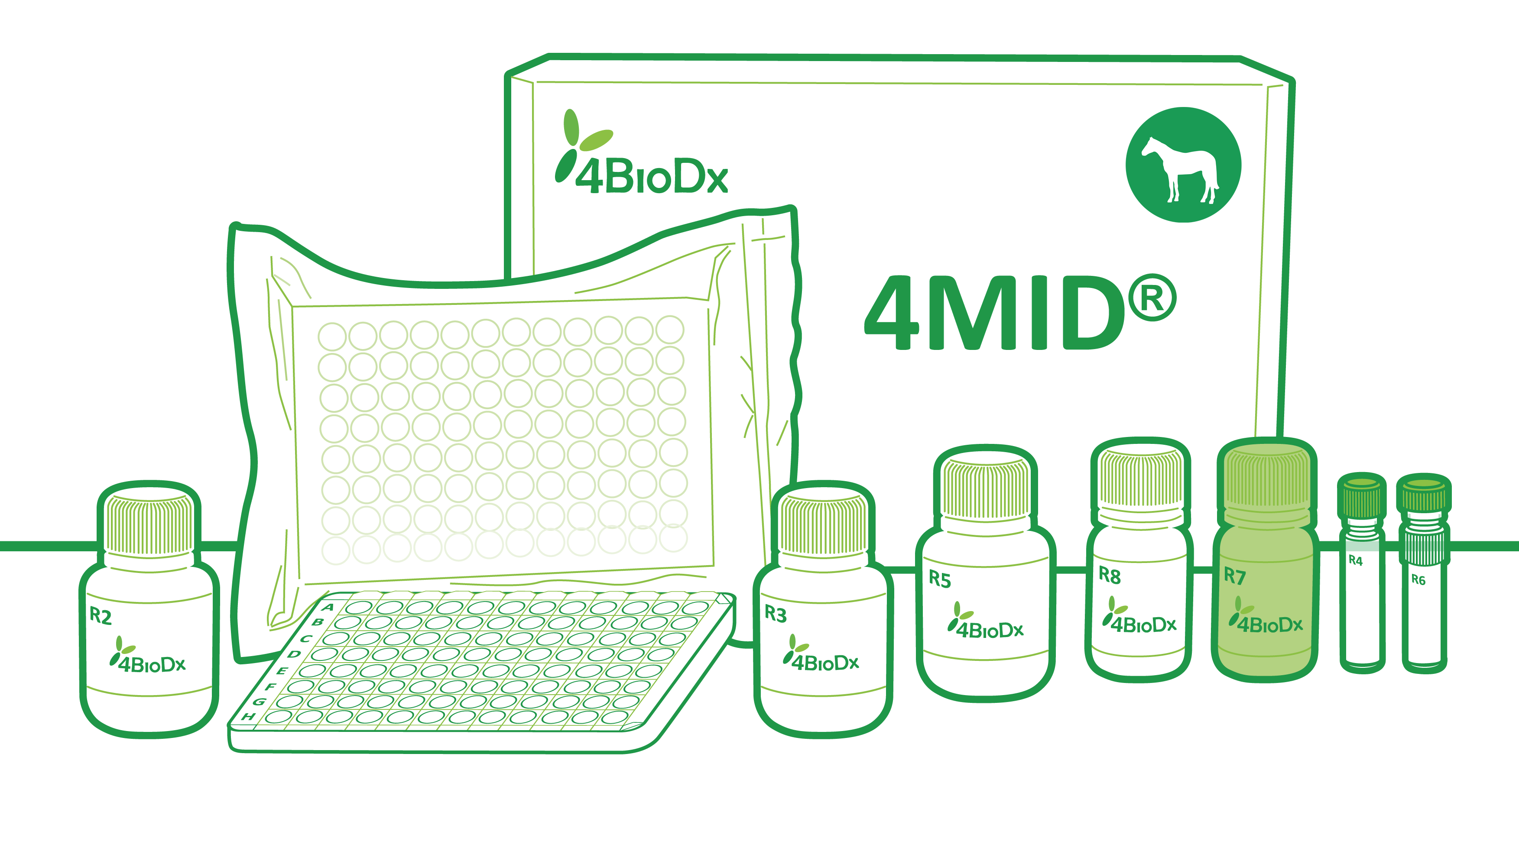
ESDAR 2021
24th Annual European Society for Domestic Animal Reproduction Conference
11 - 16th October, 2021
First online ECAR-ESDAR week

